Slide 1

Automatic Question Generator
PROJECT GUIDE: SUBMITTED BY:
Mr. Arpit Agrawal Atisha Gupta 16I7009 Kanishk Tiwari 16I7020
Priyanshi Gupta 16I7038

Slide 2
INTRODUCTION
Question generation can help to generate questions from the given text automatically. It is a process in which given an input text to the system it will create reasonable questions from the input as output. The potential benefits of using automated systems to generate questions helps reduce the dependency on humans to generate questions and other needs associated with systems interacting with natural languages. Question generation can be applied in many fields like intelligent tutoring systems, MCQ generation, FAQ generation etc.

Slide 3
Reason for choosing the Project
Nowadays, teachers/professors/tutors (academicians) spend a lot of time generating test papers and quizzes manually. Similarly, students spend a lot of time on self-analysis (self-calibration). Moreover, students are dependent on their mentors for the self-analysis. Hence, we are working on this NLP area, which has a huge scope of development at this moment. We want to build a computer application system that can help you in calibrating yourself and remove any dependencies on mentors. Here, students can give the input text of whatever material they referred to, and on this basis they get a set of questions with answers from which they can do a self-analysis (self-calibration). A similar approach is used by mentors for creating test papers and quizzes.

Slide 4
Problem Description
The system will take a paragraph as input and generate important questions from the important sentences extracted from the paragraph. It will generate different wh-type of questions from those selected sentences. The questions will be generated from both the complex and the simple sentences. It will consider only those complex sentences which consists the following discourse connective: because, and, since, when, as a result, for example, for instance.

Slide 5
Techstack & Tools used
PYTHON : Language used for implementation
PYTEXTRANK : Python implementation of TextRank to generate meaningful key sentences.
RAKE-NLTK : Offers keyword extraction
WORD2VEC : Determines words semantically similar to a given keyword
NLTK LIBRARY : Pos Tagging, Tokenisation and Parts if speech

Slide 6
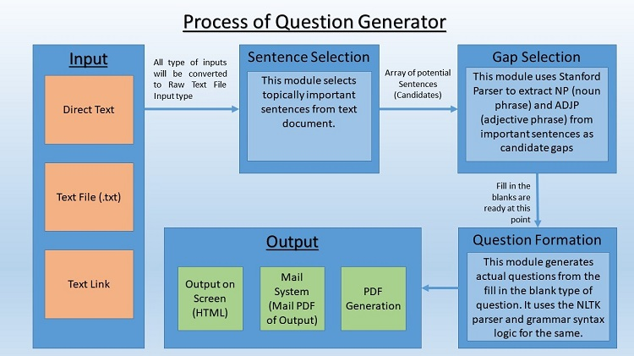
Implementation

Slide 7
Steps Involved
Our system works with the following strategy:
Step 1. Select the best potential set of sentences from the given text input from which we could generate the questions. (Sentence Selection)
Step 2. Find the subject and context of the sentence to find its core agenda. (Gap Selection)
Step 3. Analyze which is the best form of question that can be generated from that sentence. (Question Formation)

Slide 8
Types of question
Using the following strategy we can make 4 type of questions:
Type 1. Fill in the blanks
Type 2. Multiple choice questions : We will be using libraries like word2vec etc to get semantically similar words as our keyword.
Type 3. Wh-Questions
Type 4. True?False

Slide 9
Existing Solution
Manish Agarwal and Prashanth Mannem, Automatic Gap-fill Question Generation from Text Books, Language Technologies
Husam Ali, YlliasChali, and Sadid A. Hassn, Automation Of Question Generation From Sentences, In proceedings of third workshop of Question Generation
Manish Agarwal, Rakshit Shah and PrashanthMannem. Automatic Question Generation using Discourse Cues.

Slide 10
Further Research
Ideas that warrant consideration for future implementations include:
Using information from previous sentences or previously inputted texts to form questions and false answers.
Expanding question types, including types for more abstract subjects such as quantum physics and abstract mathematics.
Building a stable platform around the system (Web App) that allows the scanning of textbooks (Using OCR) to trigger question generation, has features to allow a professor to dismiss, edit, or add questions, and learns of which questions cause struggles for different students.

Slide 11
Conclusion
Our system can be used in multiple self-analysis scenarios. For example, students can use it to make learning easier as well as more interactive and interesting. Teachers and professors can use this system to quickly create a quiz. A central examination board can use this system to generate a unique test that is not known to any professor, eliminating the possibility of cheating and thereby securing the privacy and integrity of the examination.
There are very few competitors in the field of NLP. The major competitor is IBM Watson*, which can answer any question but cannot (so far) generate questions themselves

Slide 12
THANK YOU

